Slide 1

JPEG IMAGE COMPRESSION
DIGITAL SIGNAL PROCESSING-GROUP PROJECT
EE21B001-A.VINODH
EE21B004 - A.JAYA PRAKASH

Slide 2
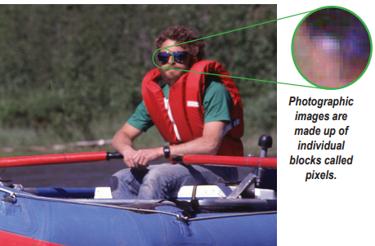
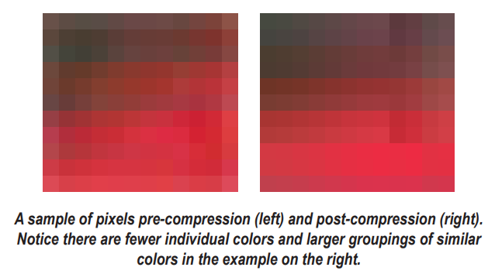
WHAT IS JPEG COMPRESSION?
JPEG Compression is the name given to an algorithm developed by the “Joint Photographic Experts Group“ whose purpose is to minimize the file size of images.
It is “lossy compression“.
An image file can be thought of as a grid of individual blocks called ‘Pixels’(Picture Element).Each Pixel has its own color values(rgb)
This algorithm exploits the fact that human eye cannot perceive high frequencies.

Slide 3




1
2
3
4
5
Extraction of Red,Green and Blue channels
Dividing the channels into 8X8
Applying DCT on each 8X8 block and then quantisation
Encoding using ZIg-Zag technique
Decoding and display of Compressed image
IMAGE COMPRESSION STAGES

Slide 4
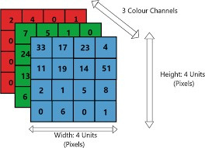
EXTRACTION OF COLOR CHANNELS
Every image is composed of small blocks called pixels. Each pixel represents the intensity of the image at that location.
Every color can be represented by combinations of different values of Red,Green and Blue each ranging from 0 to 255.
Image is stored as 3 two dimensional matrices each
representing pixels values at that location of Red,
Green,Blue colors.

Slide 5
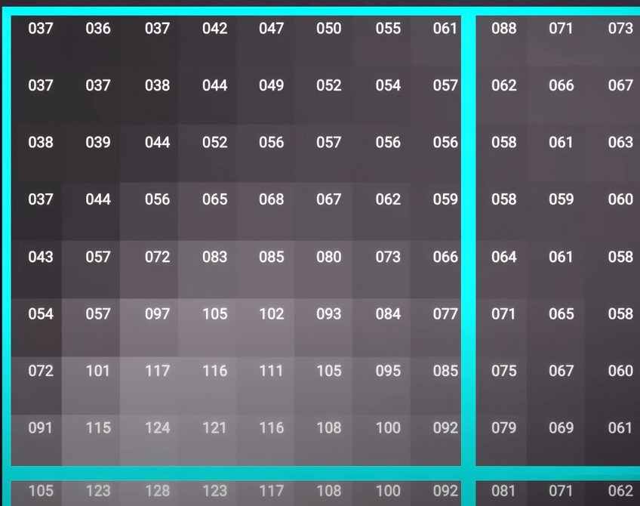
DIVIDING EACH CHANNEL INTO 8X8 BLOCKS
For Computing DCT the color channel is divided into 8X8 blocks
For example, a 1024X1024 pixels image has 128 horizontal and 128 vertical 8X8 blocks when divided.

Slide 6
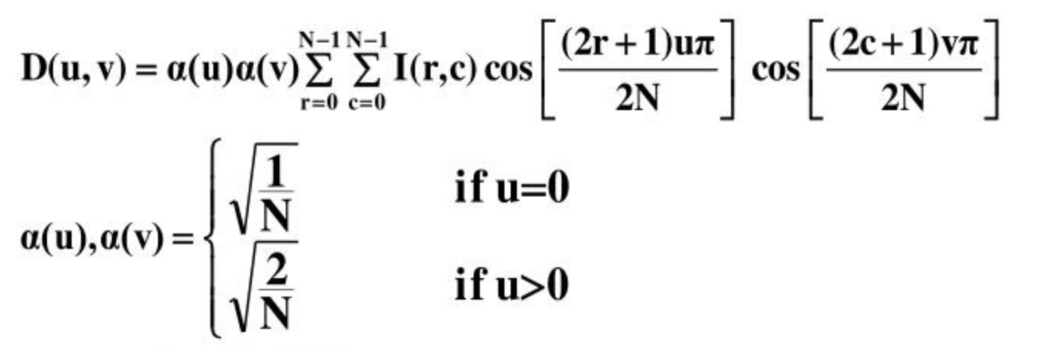
DISCRETE COSINE TRANSFORM (DCT)
The Discrete cosine transform is the basis for many image compression algorithms which use only cosine functions of different frequencies.
Assuming an Nxn image the dct equation is given by

Slide 7
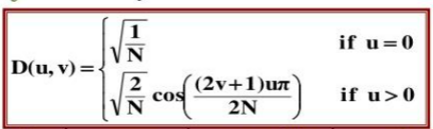
One clear advantage of DCT over DFT is that there is no need to manipulate complex numbers.
dct is designed to work on pixel values ranging from -128 to 127 for gray or color images.So the original image block is first ‘leveled off’ by subtracting 128 from every pixel value.
Matrix form of DCT is given by

Slide 8
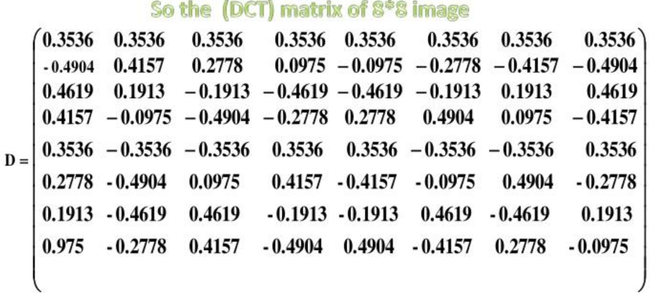
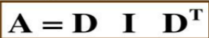
D is discrete cosine transform matrix
I is given image
DT is transpose of D
A is dct of I

Slide 9
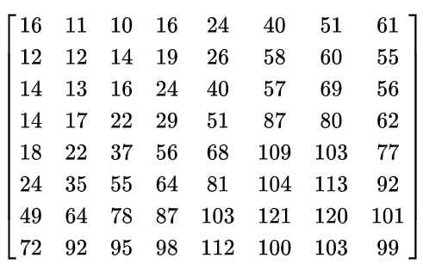
QUANTIZATION
This is the lossy part of the compression.
We divide the matrix ‘A’ obtained from DCT by corresponding values of ‘Q’ and then round the value to its nearest integer.
here Q is called the quantization matrix
This matrix decides how much that image can be compressed
We can observe that the values at the top left corner are small
where distinct patterns are located.As we go to the right the values increases where higher frequenciesare present which our eyes can’t easily perceive.

Slide 10
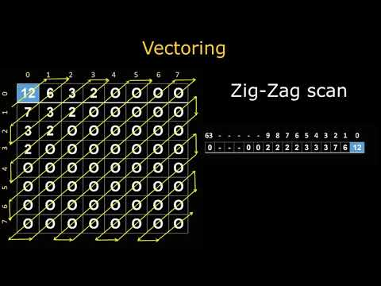
ENCODING USING ZIG-ZAG TECHNIQUE
WE WILL TRAVERSE THE 8X8 BLOCK IN A ZIG-ZAG FASHION
WE CAN OBSERVE AFTER QUANTISATION THE VALUES AT THE BOTTOM BECAME ZERO.SO WHILE TRAVERSING IF WE ENCOUNTER A LOCATION AFTER WHICH ALL THE VALUES ARE ZERO WE WON’T STORE THEM.THERBY REDUCING THE DATA STORAGE OF THE IMAGE.

Slide 11
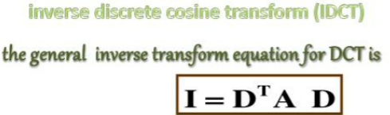
DECODING AND DISPLAYING THE COMPRESSED IMAGE
TO GET THE COMPRESSED IMAGE WE DECODE THE ENCODED VALUES.WE RETRACE THESE ENCODED VALUES TO GET 8X8 BLOCK.
AFTER GETTING THE 8X8 BLOCK WE MULTIPLY IT WITH THE QUANTISATION MATRIX AND THEN WE APPLY THE INVERSE DCT.
FINALLY WE DO LEVEL SHIFT BY 128 PIXELS

Slide 12
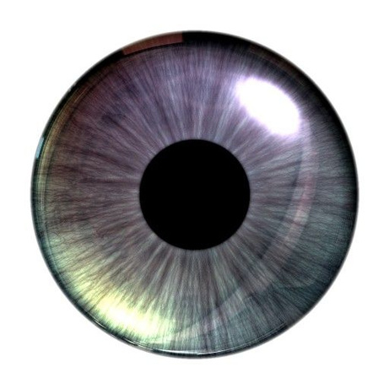
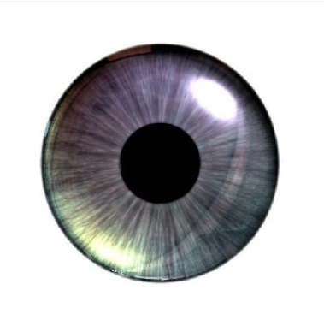
TEST SAMPLES
ORIGINAL IMAGE
IMAGE SIZE = 512*512*3*8
=6291456 BITS
COMPRESSED IMAGE(COMPRESSION FACTOR = 1)
IMAGE SIZE = (38970+38829+39203)*8
=936016 BITS

Slide 13
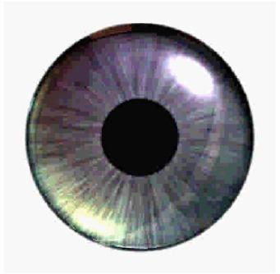
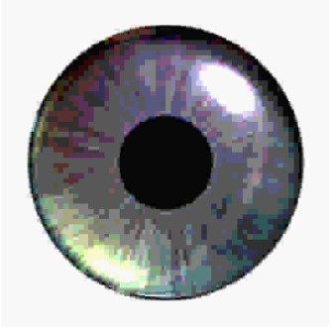
TEST SAMPLES
COMPRESSED IMAGE(COMPRESSION FACTOR = 10
IMAGE SIZE = (11358+11423+11318)*8
=272792 BITS
COMPRESSED IMAGE(COMPRESSION FACTOR = 20)
IMAGE SIZE = (8923+8936+8729)*8
= 212704 BITS

Slide 14
TEST SAMPLES
ORIGINAL IMAGE
66.7% COMPRESSION
23% COMPRESSION
30% COMPRESSION

Slide 15
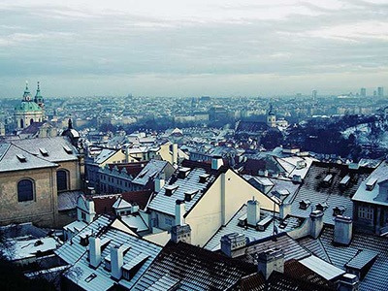
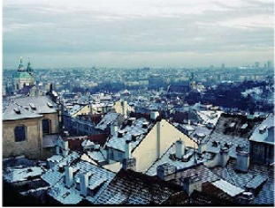
TEST SAMPLE(UNEVEN SIZE AND PIXELS NOT MULTIPLE OF 8)
ORIGINAL IMAGE
IMAGE SIZE = 300*400*3*8
=2880000 BITS
COMPRESSED IMAGE(COMPRESSION FACTOR = 1)
IMAGE SIZE = (56824+56521+56830)*8
=1361400 BITS

Slide 16
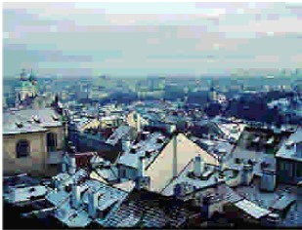
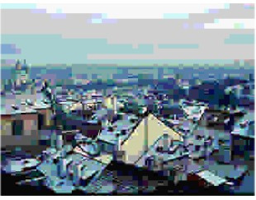
TEST SAMPLES
COMPRESSED IMAGE(COMPRESSION FACTOR = 10
IMAGE SIZE = (14127+14233+14178)*8
=340304 BITS
COMPRESSED IMAGE(COMPRESSION FACTOR = 20)
IMAGE SIZE = (7406+7597+7398)*8
=179208 BITS

Slide 17
TEST SAMPLES
ORIGINAL IMAGE
3% COMPRESSION
10% COMPRESSION
16% COMPRESSION

Slide 18



THANK YOU
EE21B001-A.VINODH
EE21B004 - A.JAYA PRAKASH

